Slide 1

NDMA CUAS Specialist Course
CMS Configuration Tool

Slide 2
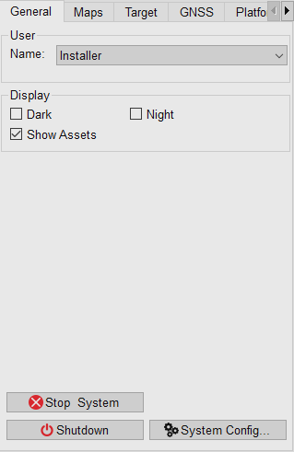
CMS Configurator Tool
The CMS Configurator tool, currently only available at Installer Level.
Access to this level is Password Protected: ChessDynamics
Entering the “System Config” will open the tool
Caution: Changing parameters within the Configuration tool could stop the system operating correctly.
Notes:
We looked at individual components in the Operator Section, this goes further into the system make up to provide further system knowledge.

Slide 3
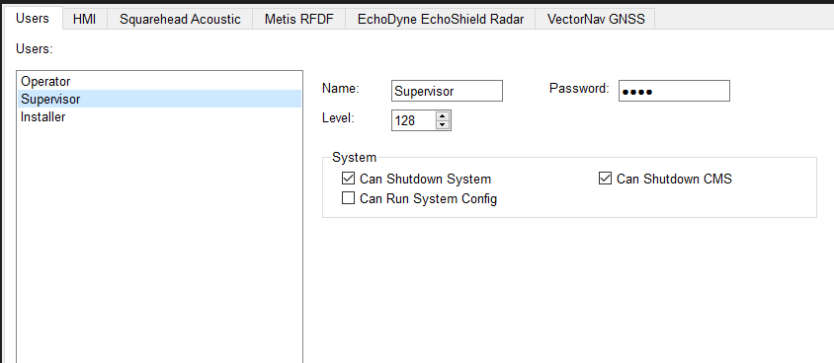
CMS Configurator Tool - User Management
It is possible to add as many individual user/operator levels as you would like
Name, Password and user level can be individually set.
Level is set from 0 to 255
Notes:
Level, this is a figure from 0 to 255 and denotes what the user is capable of manipulating in the system.
Within the user page, you can set if the each user is capable of shutting down system, CMS or can run the system configurator.

Slide 4
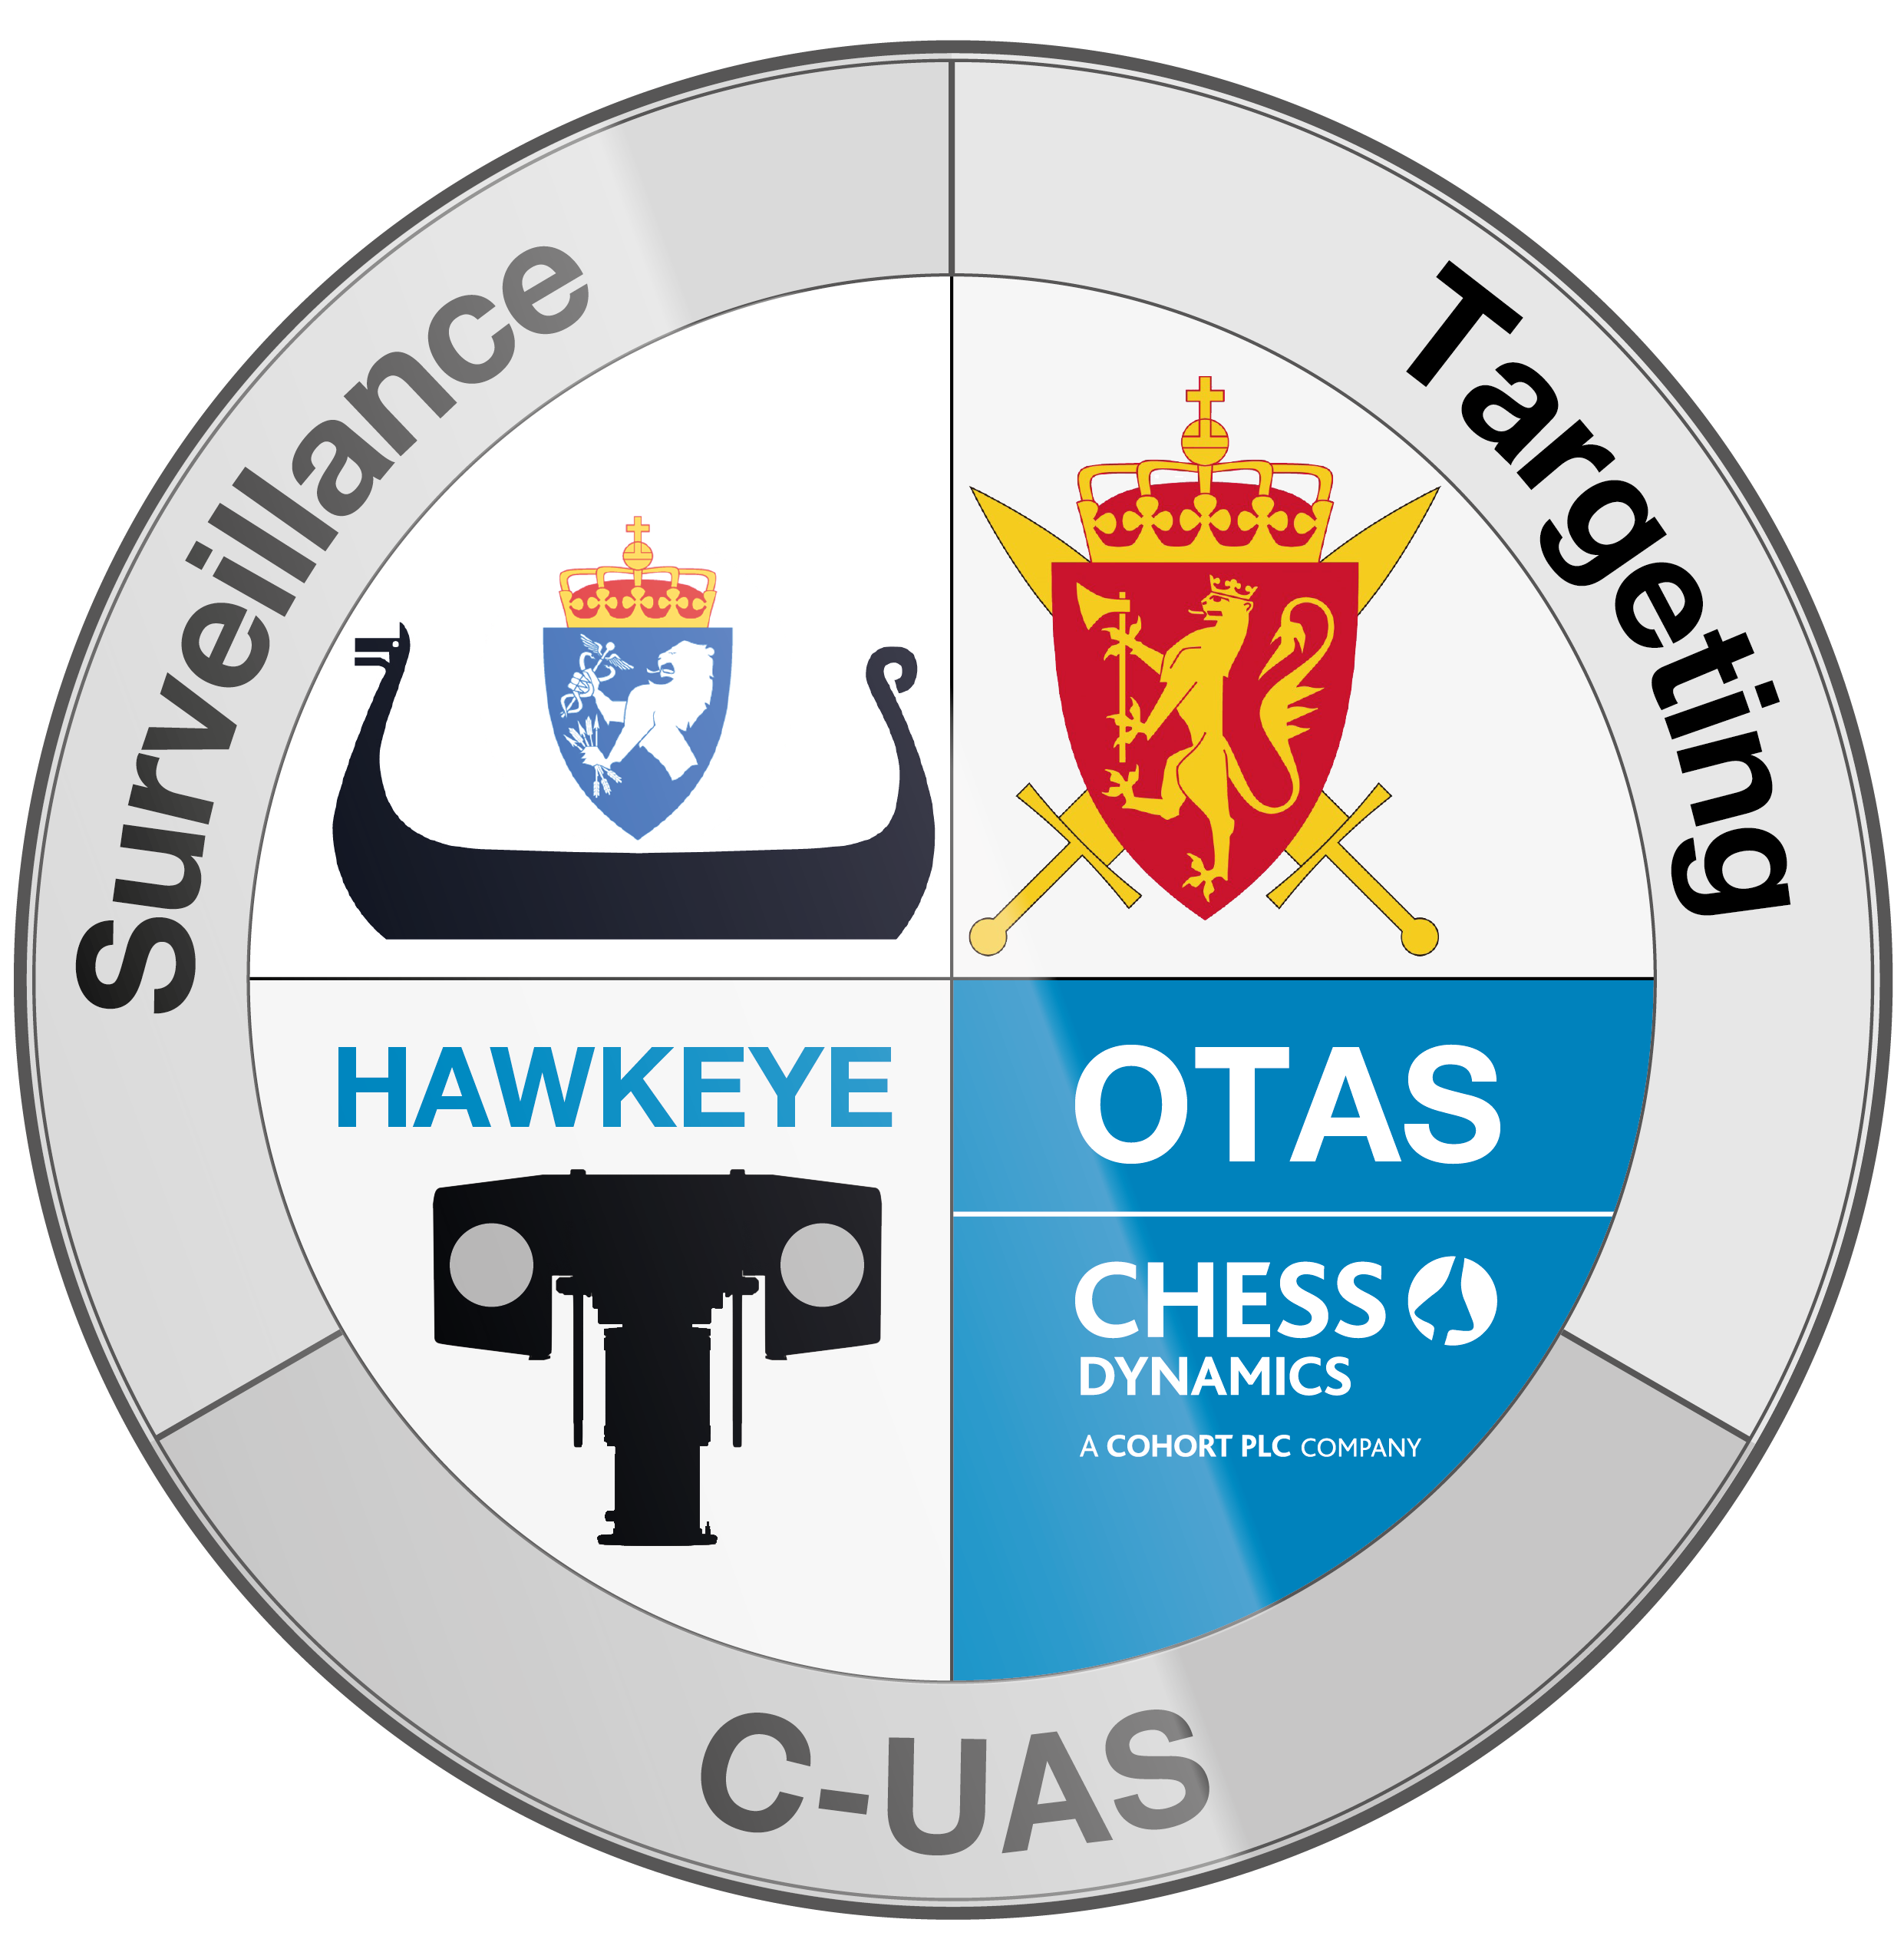
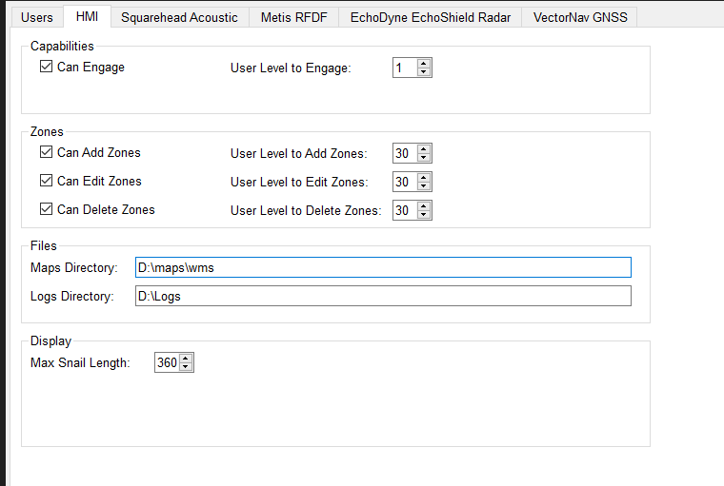
System Overview – CMS Configurator Tool - HMI
HMI relates to what can be added or edited in the user interface.
Capabilities: Can the user Engage?
Zones: Within this example, Level 30 users can add, edit and delete zone.
Files: There should be no reason to change the defaults in the system.
Snail Length: Denotes the length a track can be “Snail Trail”
Notes:
Leveling can be increased or decreased as seen fit.

Slide 5
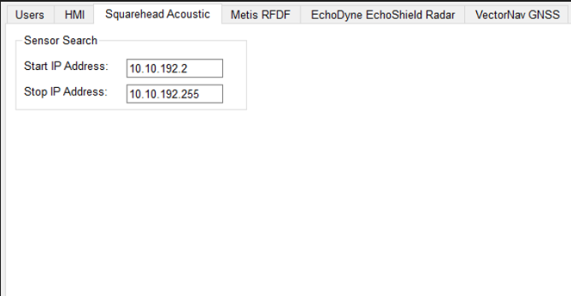
System Overview – CMS Configurator Tool - Squarehead
This denotes the address range that the CMS will search for active Nodes
This is dependent on the nodes in use.

Slide 6
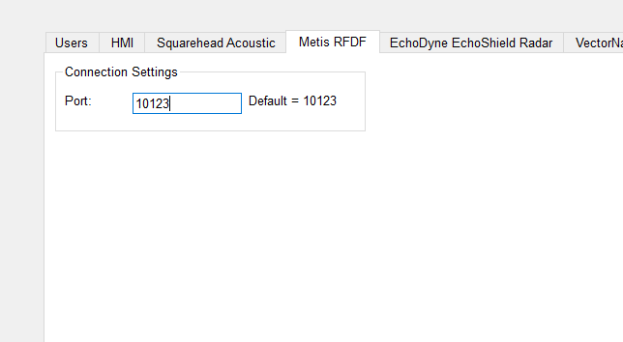
System Overview – CMS Configurator Tool – Metis RFDF
For Information, this is the internal Ethernet port where data is forwarded to from the Metis system.

Slide 7
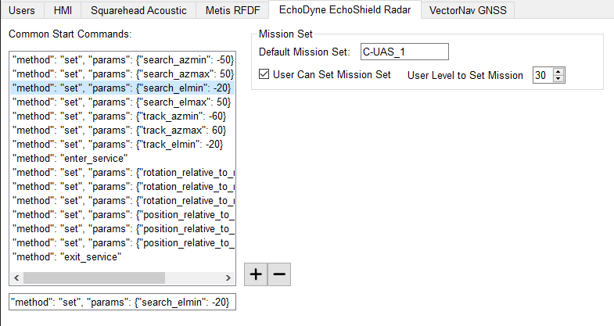
System Overview – CMS Configurator Tool – Radar
Radar Parameter setting.
This section is Global parameters used across all radars and instruction sent on start of transmission.
Default Mission set is C-UAS_1
Defined for tracking and classifying smaller drone types.
Maximum Ranges
130° Azimuth maximum ( ±65° )
90° Elevation maximum ( +50°/-40°)

Slide 8
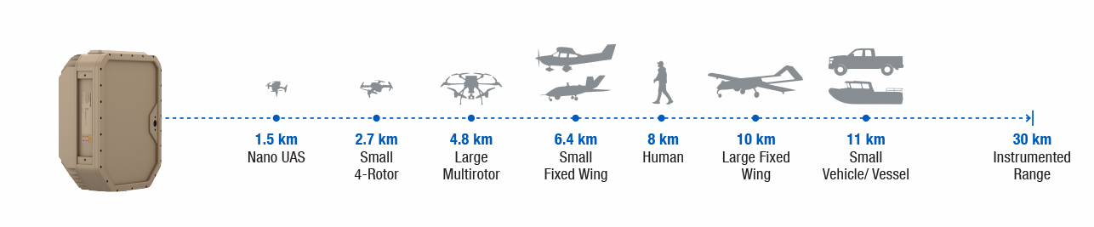
System Overview – CMS Configurator Tool – Radar Mission Sets
C-UAS_1
The C-UAS_1 mission is optimized to provide air space situational awareness against group 1 UAS at ranges
less than 4km. The mission has been designed to provide a minimum track acquisition range of 150 meters, a
minimum blind range on tracked targets of 100 meters, and a 50% track acquisition range on a -20 dBsm target
of 2.5km. This mission is expected to be able to track ground targets in a limited capacity. The C-UAS_1
mission is recommended for customers looking to track group 1 UAS and smaller targets.
C-UAS_2
The C-UAS_2 mission is optimized to provide air space situational awareness against group 1-3 UAS at
ranges up to 15km. The mission has been designed to provide a minimum track acquisition range of 500
meters, a minimum blind range on tracked targets of 100 meters, and a 50% track acquisition range on a -20
dBsm target of 2.5km. This mission is expected to be able to track ground targets in a limited capacity. The
C-UAS_2 mission is recommended for customers looking to track group 1-3 UAS or targets of similar size
and speed.
DISMOUNT
The DISMOUNT mission is optimized to provide ground situational awareness at ranges up to 12.5 km. The
mission has been designed to provide a 50% track acquisition range on a -3 dBsm target (human) of 8km.
This mission is not expected to be able to detect and track airborne targets. The DISMOUNT mission is
recommended for customers interested in tracking targets on the ground.

Slide 9
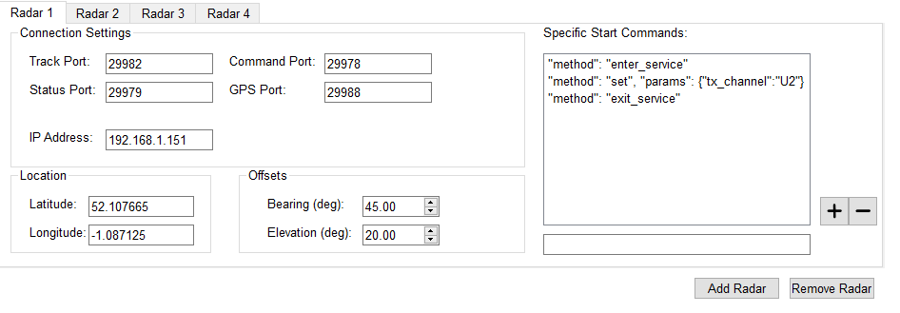
System Overview – CMS Configurator Tool – Radar
Radar Specific Settings
If setting are changed, this will alter how the radars operate, so should be understood before changing.
Notes:
Radars 2, 3, and 4 are the same, expect the values will be different to account for the differing offsets.

Slide 10
System Overview – RF Defeat Safety
Questions?

Slide 11
Blank Slide Template - Slide Title
Additional Information

